Slide 1
Doordash
Developing the product
Product Owner: Francesco Malagrino
© 2019 Udacity. All rights reserved.

Slide 2
Getting Started

Slide 3
Create Project Blueprint
A product launch is not just about deploying a beautifully designed,built and thoroughly tested feature. Your company needs to be equally prepared if not more to support every possible customer interaction associated with the product (e.g landing on your company website to learn more about the new feature)
© 2019 Udacity. All rights reserved.
Notes:
[ALL PARTICIPATION]

Slide 4
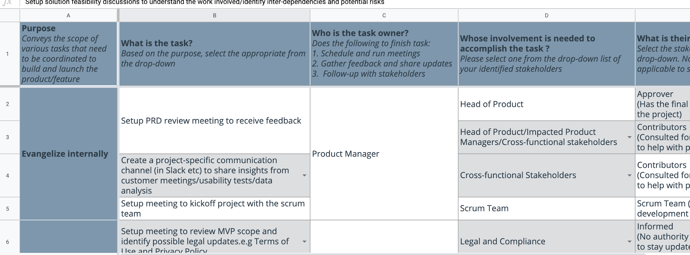
Create a coordination activities map
Share your project-specific coordination activities map here (Insert Link here). You can also share a screenshot below.
© 2019 Udacity. All rights reserved.

Slide 5
Plan for Sprint Meeting
As a PM, it is important to stay ahead of your scrum team and be prepared for every upcoming sprint by having a target goal defined with prioritized backlog for team to start costing and breaking down the tasks
© 2019 Udacity. All rights reserved.
Notes:
[ALL PARTICIPATION]

Slide 6
Sprint Planning Meeting Preparation
Sprint Goal
Enable anew feature for the customer to view where the robot it is and send a sms with a code
Sprint Backlog (list the prioritized user-stories from the product backlog)
1 | As a customer of Doordash I want to know how long need to wait until my food arrive
2 | As a customer of Doordash I need to order item
3 | As Doordash We need to know where is the robot to make sure he skip any obstacles
4 | As Doordash we need to protect the robot against theft
5 | As a Customer of Doordash I want to have receipe to create dishes.
Sprint Prioritization Logic
A fully implemention at the end of the sprint Prioritize the riskier work to create API integration ahead it may require multiple sprint
© 2019 Udacity. All rights reserved.

Slide 7
User Story 1
User Story | As a customer If I want to use the Autopilot function , I need to enter my phone code to receive an SMS to authenticate.
Design | Please look slide 8
Acceptance Criteria | A user need first insert the SMS One the User will receive the code the user need to insert the code to enter The user will receive a code
Assumptions | The customer need to put his own number of phone and receive an SMS I assume that the engineering are selecting any platform that send the sms for free without recurring in extra charge
© 2019 Udacity. All rights reserved.

Slide 8
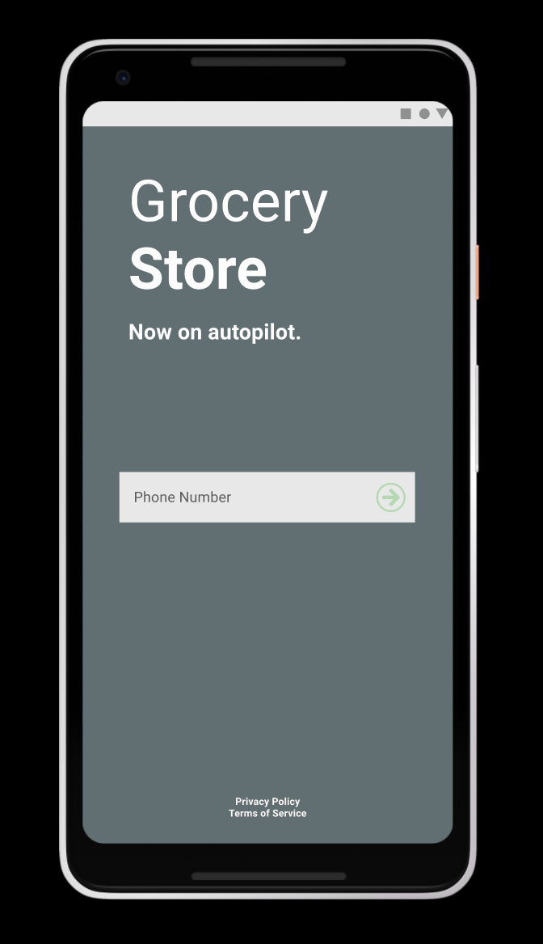
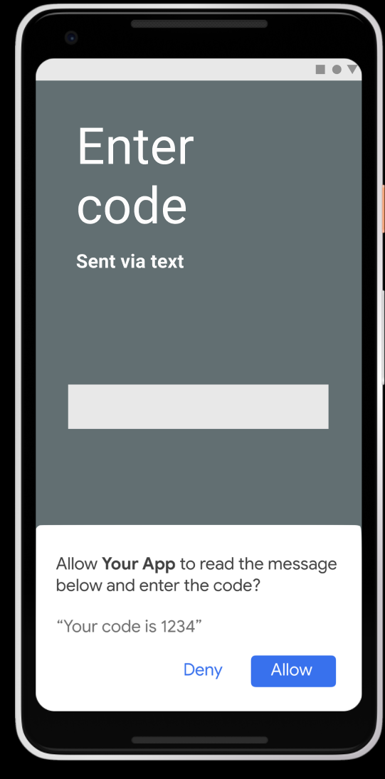
Design user Story 1
© 2019 Udacity. All rights reserved.

Slide 9
User Story 2
User Story | As a customer I want to order items and choice if subscribe and receive the same items every month tot times or just order once
Design | Please check Page 10
Acceptance Criteria | The customer need to order an item The customer need to select if they want the item monthly with a subscription or just order the single item. The subscription function is a recommend system based on their past purchased
Assumptions | The Customer need to buy using our App and may want to know how many times per month he buy the same item I assume that the engineering are selecting any platform that send the sms for free without recurring in extra charge
© 2019 Udacity. All rights reserved.

Slide 10
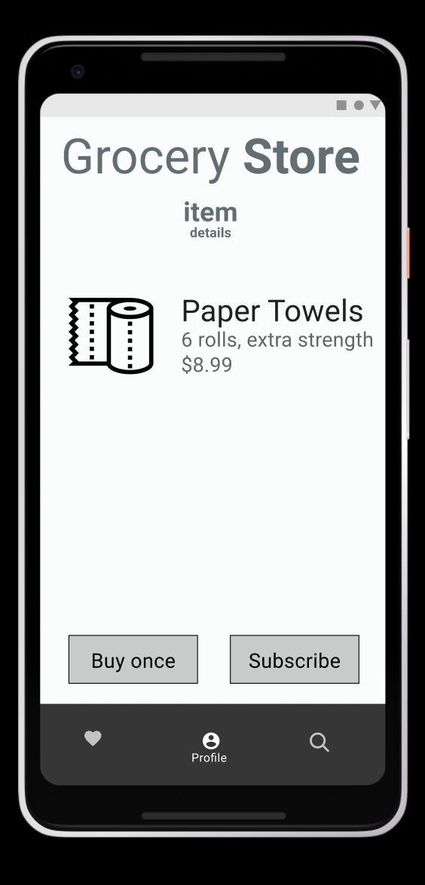
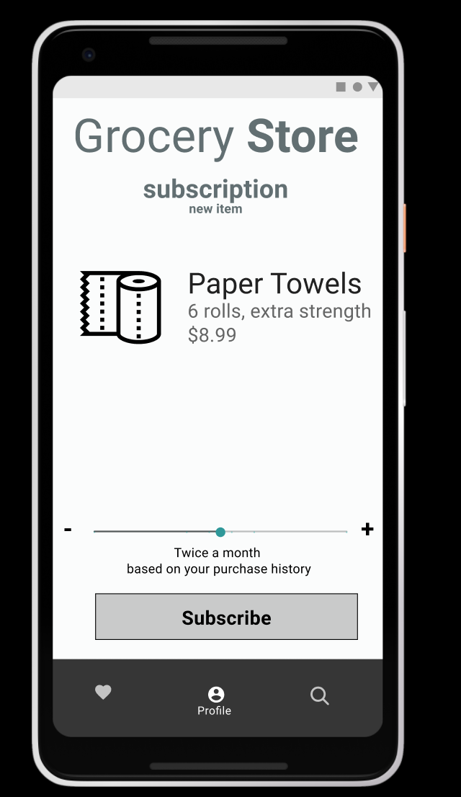
Design user Story 2
© 2019 Udacity. All rights reserved.

Slide 11
Decoding API Documentation
As a PM, you will collaborate with the engineering team and provide guidance that heavily influences their development approach. When a product requires an API integration, sometimes PM need to be “technical enough” to understand the following to refine the solution with designer and development team
what information is available via the API
how is it available
possible pricing impact
© 2019 Udacity. All rights reserved.
Notes:
[ALL PARTICIPATION]

Slide 12
DoorDash Project
Based on the API documentation how would you update your solution and design? | The robot must use a mix of 2 of the google API 1 is direction from shop to the customer location and we must use as well the Google distance matrix to undertand the distance and estimate the delivery time
Based on your high-level understanding of the API documentation, are there any details that you want to discuss with engineering to refine solution and/or determine feasibility | Is the accurancy of the distance with the Google APi 100% true? Is Google API the best? There is any other API that we can use? If yes what are the alternatives pro and contro for each

Slide 13
Re-prioritize Sprint Backlog
As a PM, unexpected issues and new feature requests will require you to triage them efficiently and re-prioritize the sprint backlog without impacting the roadmap deliverables significantly
© 2019 Udacity. All rights reserved.
Notes:
[ALL PARTICIPATION]

Slide 14
Issue 1 High priority: Landing Page loading too slow
Determine impact and criticality to prioritize issue | Assume that the landing page uses javascript and has few dependencies. The customer have a slow or issue with the network and ergo the landing page is pretty slow so for this reason is a low priority only the 5% of the users are impacted from this issue The landing page is slowly also because we use an heavy Javascript, we may need to change javascript library and try to found a lightweight javascript for this reason is a high priority and the 40% of the users are impacted due to slow landing The landing page is slowly because we don’t use any cache item if we use a cache system will be slow immediately after the first time for this reason is an high priority only the 40% of the users are impacted from due to slow landing
Next Steps You would carry out typically using JIRA (ticketing tool), communication channel (Slack) | Jira issue about the different type of issue on the landing page : Jira priority 4 : this is a low priority If the landing page it’s slow due the network or for customer network issue is not our fault but most of the customer but we can try to have an offline homepage to avoid this issue only the 5% of the customer are impacted from this issue Jira priority 2 : This is an High priority if the landing page is slowly because we use an heavy javascript we must use an lightweight javascript, not every customer have the most recent and top of gamma smartphone 40% of the cust Jira priority 2 : This is an High priority if the landing page is slowly to load because we don’t use any cache item and so need to load all the times logo and banner Communication : Create a slack channel with the stakeholders and explain the issue and the solutions
Would you take additional steps ? | I need to create a slack channel with this issue with Engineering , i don’t want have anymore an issue like that and need to discuss with Engineering to found the quickest and solid solutions, no workaround.
© 2019 Udacity. All rights reserved.

Slide 15
Issue 2 High : Misaligned fields in the ZIP Code page
Determine impact and criticality to prioritize issue | Assuming that a customer is entering the zip code but cannot check it because the image is ovverring the field. The user can’t see properly the ZIp Code field and can’t check if he wrote the correct Zip because the Zip Code is on the center of the application but is hidden from a picture this is effecting 75% of the users.
Next Steps use ticketing tool (JIRA), and communication channel (Slack) | Jira Priority 2 the zip code is override from a picture since is effecting the 75% of the users this jira issue is very high priority, I will need to Slack with Designer We need to change the padding or Margin of the picture for display less big of 6 inches so doesn’t ovveride the zip code field in this way we won’t recurring anymore in any other issue with mobile less big of 6 inches
© 2019 Udacity. All rights reserved.

Slide 16
Respond to Customer Service Manager’s Email
Determine impact and criticality to prioritize the issue (1 - Critical; 2 - High; 3 - Normal; 4 - Low) | Our internal tool’s “send code” is not working. We are able to trigger the code (containing the link to open the robot) this is a 1 so a critical issue and is affecting the 30% of our customer, Sometimes our customer are receiving the SMS 10 minutes after this priority is 2 so high priority, this is affecting the 10% of our customer
Next Steps You would carry out typically using JIRA (ticketing tool), communication channel (Slack) | JIRA : Open two bugs one with priority 1 and the other one with Priority 2 and describe the issue with the step to replicate the issue. Communication : Channel Slack with the Engineering to understand why the SMS is not been sent and received from the customer Communication : Create a meeting with all the groups involves
Sample Email Response | Hi , I spoke with the Engineering and we know that this issue is due two Mobile operator. We are working hard to resolve this issue as soon as possible we are thinking to use Twillio in this way we won’t face this issue anymore Many thanks and best regards
© 2019 Udacity. All rights reserved.

Slide 17
Handle Potentially Difficult Situations
As a PM, you will be faced with many unexpected situations where you have to make a decision or push back while managing competing priorities from stakeholders and tackling issues that could potentially affect your product launch
© 2019 Udacity. All rights reserved.
Notes:
[ALL PARTICIPATION]

Slide 18
Respond to CEO or GM’s request via email
Assessment and result | The product feature is 65% functionality complete and not fully stable yet since Mine development team is deploying changes to the QA environment frequently to verify the completed tickets and bug fixes. The typical procedure involves having a staging environment where fully tested,stable and functional features are deployed
Sample Email Response | Hello CEO, There is no problem to do a demo in 2 days we are in timeline and we will provide the demo in 2 days note that is not a fully demo we will show around the 70% of our product and we may do a complete demo in 2 weeks time. In this demo we will show the following features : Authentication with SMS code The Zip code just at the moment works with The grocery shop Autopilot In two weeks time we will show a second demo Where will show the Coupon offer feature. Many thanks and best regards
© 2019 Udacity. All rights reserved.

Slide 19
Step-in and guide the scrum team at stand up
Video Response | Please check the zoom 1 rar
© 2019 Udacity. All rights reserved.

Slide 20
Handling Resource Constraints
List 2- 3 activities that you would carry out as a PM to unblock the scrum team immediately ? | I will setup meeting to kickoff project with the scrum team I will coordinate the Scrum master to unblock the team so they can immediately start I will setup slack chat with all team so the team can update any progress of their work or ask anything in case they have doubs
Since the QA team member is shared across multiple projects, how would you coordinate with other PMs to de-risk your project and raise appropriate visibility ? | I will Setup solution feasibility discussions to understand the work involved/identify inter-dependencies and potential risks I will identify critical issue and prioritize them so the team can start to work I will identify critical spike and engineering design work to complete prior to product/feature development so we can organize the sprint and the next releases.
Since there is a potential risk, it is important to raise visibility amongst appropriate stakeholders | The stakeholder think is better use this technology rather the technology used in the prototype The stakeholder this the coupon feature is very good but he want we improve the layout
 | Your point in good but we need to evaluate these new solutions against our guiding principles and stick with what we have been decide.
© 2019 Udacity. All rights reserved.

Slide 21
How would you handle stakeholder feedback?
Feedback Assessment | What do you think about our Notification coupon feature? Do you like? What do you think about the product after fix the login page is fast enough? Are you ready to launch the product?
Video Response | Please check the video 2 rar
© 2019 Udacity. All rights reserved.

